Slide 1
EAT 1: Overview
© agsandrew/Shutterstock.com

Slide 2
EAT is a research-informed integrative assessment framework that helps you to consider all aspects of assessment practice and the interrelationships between them with colleagues and students.

Slide 3
Importance of assessment as an individual and collective process that considers individual and organisational facilitators and barriers

Slide 4
EAT Promotes:
Equity
Agency
Transparency
In assessment

Slide 5
Underpinning premise of EAT:
How students come to co-own their programmes
with lecturers and see themselves as
active contributors to the assessment feedback process rather than seeing assessment as something that is done to them (EAT, 2016)

Slide 6
EAT Dimensions
It comprises 12 inter-related areas related to Assessment Literacy
Assessment Feedback
Assessment Design

Slide 8
The EAT Framework origins:
Making sense of assessment and feedback: A research-informed approach
http://journals.sagepub.com/doi/abs/10.3102/0034654312474350

Slide 9
The literature base informing EAT
Cognitive styles
2013
Systematic Review of 700 articles selected from >9000
2013
Making Sense of Assessment Feedback
Systematic Review of 460 articles from >4000 articles
2015
High Impact Pedagogies and Student Engagement
Systematic Review
Review of 21,055 abstracts and selection and analysis of 1671 Detailed analysis of 273 articles
2015
Waring and Evans
Understanding Pedagogy
Emotions in learning
2016-20
EAT
Assessment and self-regulation 2018
Additional 1000 articles selected from > 10,000
Resilience
Deep approaches to learning
Maximising Success of Assessment Systematic Review of 1100 articles from > 12,000
2014
Kozhevnikov, Evans & Kosslyn
Neuroscience/cognitive & educational psychology
Teaching styles

Slide 10
Informed by a Personal Learning Styles Pedagogy
Beliefs and Values
Use of appropriate tools to support learning
Optimising conditions for learning/ sensitivity to learner context
Design of learning environments to maximize self-regulatory development
Supporting leaner autonomy: choices in learning / student voice
(Waring and Evans, 2015)

Slide 11
PLSP
A Beliefs and Values
Appropriate Tools
Sensitivity to Context
Self-regulatory Design
Learner Autonomy

Slide 12
ALL ABOUT DESIGN
Greater emphasis should be placed on assessment designs that promote student engagement with all dimensions of the assessment process as part of ‘knowing to’ (Sadler, 2013)

Slide 13
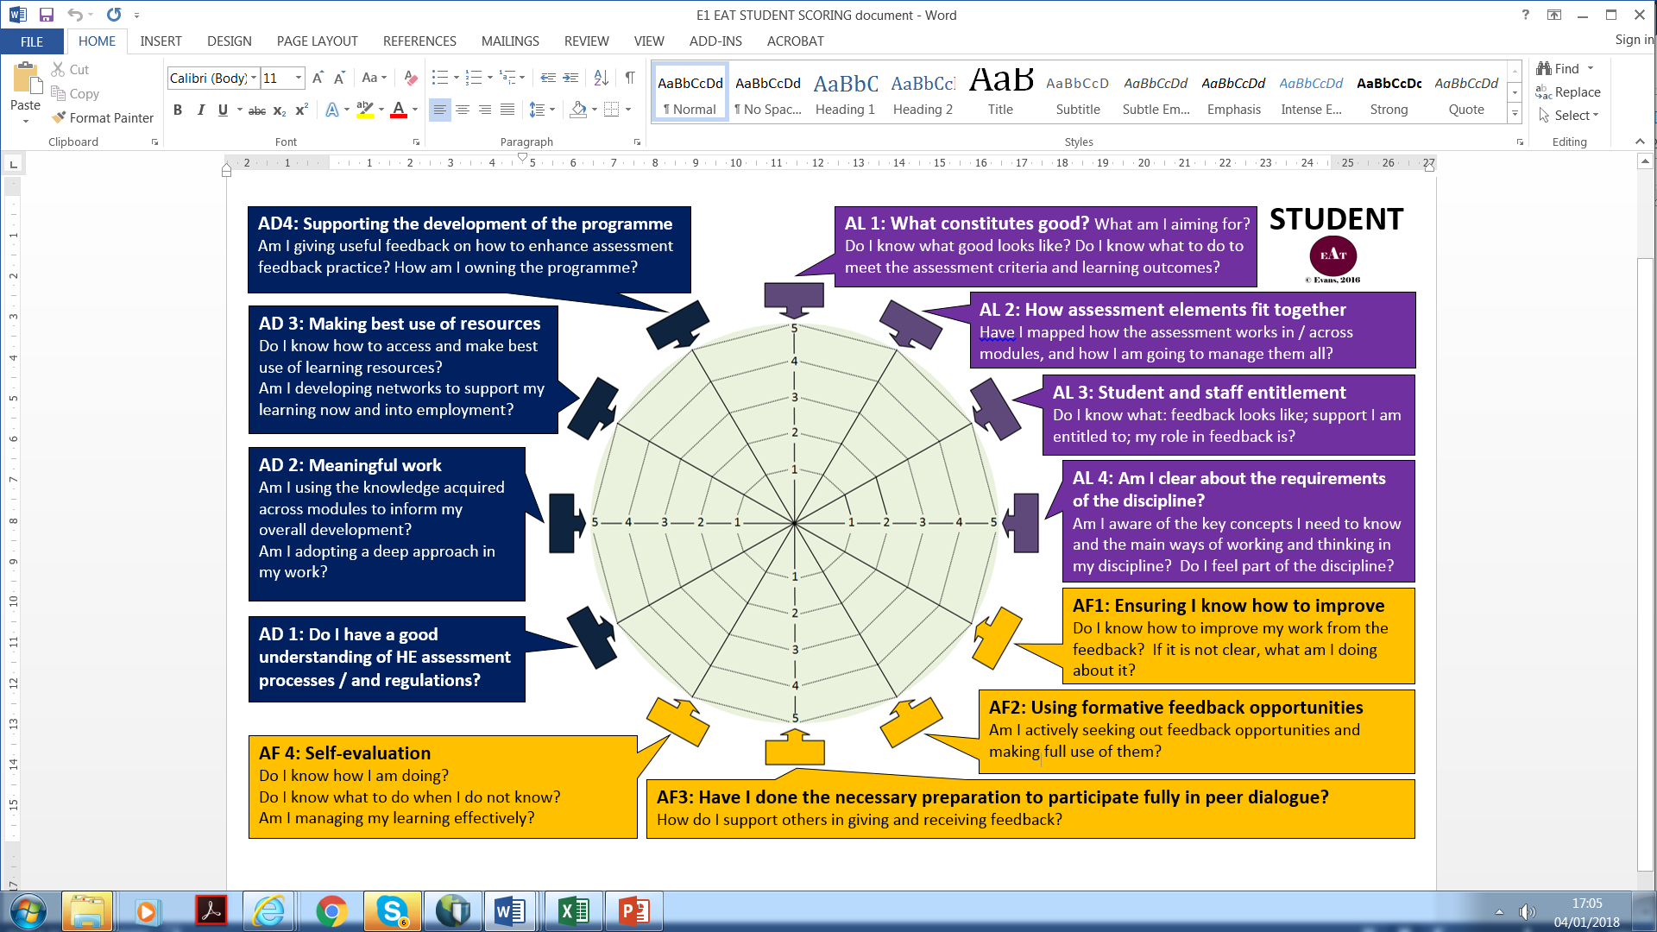

Slide 15
In reviewing your own assessment design, which areas of EAT are most in need of development?
As a team are you agreed on priorities for development?
Are there specific modules that require attention?
What are your students’ EAT profiles? Is it possible to identify ‘tribes’ with similar initial profiles and undertake a needs analysis of specific groups?
Having inducted students’ into their role within assessment, to what extent have students’ EAT profiles evolved?
What practices have been most effective in supporting student engagement with assessment?
EAT 1 Questions
© agsandrew/Shutterstock.com

Slide 16
Waring, M., & Evans, C. (2015).
Understanding Pedagogy: Developing a Critical Approach to Teaching and Learning.
Abingdon, Oxford, United Kingdom: Routledge.
http://www.amazon.co.uk/Understanding-Pedagogy-Developing-critical-approach/dp/041557174X
This book provides overview of the Personal Learning Styles Pedagogy and the theories underpinning it and how you can use the core ideas in practice. It informed the development of the EAT Framework

Slide 17
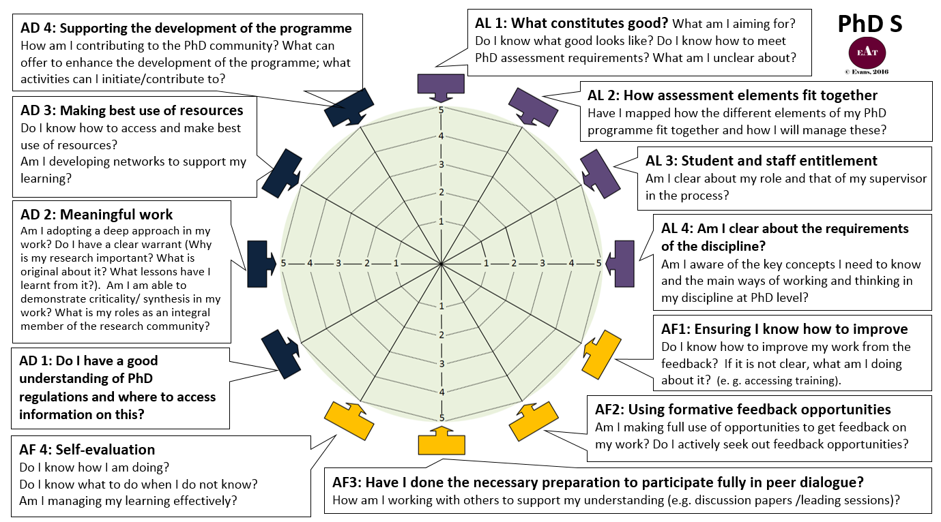

Slide 19
