Slide 1
Principles underpinning
the EAT Framework
Professor Carol Evans

Slide 3
Fundamentals
Equity
Agency
Transparency
https://www.frontiersin.org/articles/10.3389/feduc.2018.00069/full

Slide 4
How students come to co-own their programmes
with lecturers and see themselves as
active contributors to the assessment feedback process rather than seeing assessment as something that is done to them (EAT, 2016)
Issue is not to perpetuate the need for external regulation

Slide 5
ALL ABOUT DESIGN
Greater emphasis should be placed on assessment designs that promote student engagement with all dimensions of the assessment process as part of ‘knowing to’ (Sadler, 2013)

Slide 7
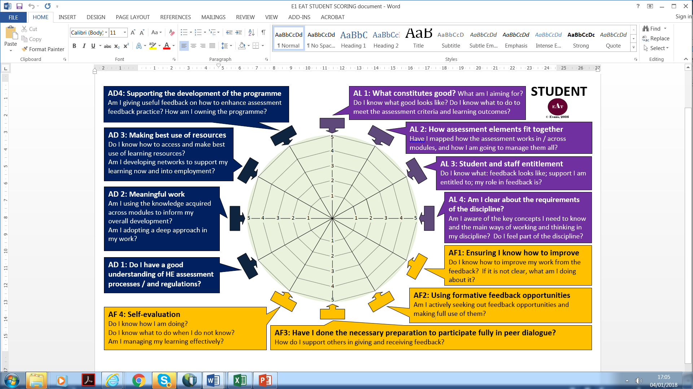

Slide 8
What we do in assessment and how we do it impacts achievement – it is the micro details of the approach and how attuned it is to context
What are the variables that impact our practice? Who are our tribes? Are they all
benefitting equally?

Slide 9
Key Themes in Effective Designs
Relevance
Real life examples
Connecting with communities within and beyond HE
Forward thinking
Design of Assessment:
The long game
Agency
Use of guided discovery experiences
Universal Design
Ensuring accessibility of materials / processes / procedures
Emphasising student self-management
Transparent
Shared ownership
Partnership
Bringing the outside in (Bass, 2012)
Engaging students in assessment design
Supporting students’ development & navigation of learning environments
Co-authorship
Partnership

Slide 10
To what extent do we have a shared understanding of
assessment and how it should be operationalised?

Slide 11
Meaningful Assessments
personalising and creating their own criteria (Taras, 2015)
being trained in using, triangulating and making sense of feedback (Evans, 2013; Forsythe & Johnson, 2017; Winstone et al., 2017).
reviewing work of varying quality (Sadler, 2010, 2013).
acting as reviewers of others (Nicol, Thomson, & Breslin, 2014).
self-assessing and feeding back to others (Boud et al. 2013; Carless, 2012; Deeley, 2014).
working with assessment to do the noticing, the thinking about repair and modification, and the generation of ways to improve (Sadler,2013, p. 57) as 'knowing to'.
co-constructing habitus in generating dispositions to act and perceive in the discipline (Gray, 2013; Yu & Hu, 2017).
working as co-producers with the wider community in boundary-crossing, integrative, and socially networked experiences, that bridge HE experiences with life outside of it (Bass, 2012).
designing assessment with lecturers (Riley, 2017; Riley, McCabe, & Pirie, 2017)
teaching and researching with peers and lecturers (Scott, Moxham, & Rutherford, 2013).

Slide 12
Strategy development is a leveller –
“Students’ strategies for learning and exam preparation, for effort regulation, and goal-setting demonstrate stronger relationships with achievement than their personalities or personal backgrounds”
(Schneider and Preckel, 2017, p. 595)

Slide 13
Best use of time
Metacognitive, Cognitive and Affective Regulation
Reducing overload especially during transitions
Clarifying requirements
Developing strategy to ‘choose deliberately when and where to invest time and mental resource’ (Schneider & Preckel, 2017)
BELIEFS AND VALUES MATTER
Role of emotions: Evans, C. (2015). Exploring students’ emotions and emotional regulation of feedback in the context of learning to teach. In V. Donche, S. De Maeyer, D. Gijbels, H. van den Bergh (Eds.) (2015). Methodological challenges in research on student learning (pp. 107-160). Garant: Antwerpen.

Slide 14
Supporting students in ‘knowing how to improve’ is about
enabling them, through course design, to regularly test their understandings, to be able to seek and use resources effectively, manage their emotions, and not be reliant on external feedback ----- taking us back to self-regulation
How are we developing an evidence-base to inform what we do?

Slide 15
What are your drivers?
Evans, with Muijs and Tomlinson (2015)
‘To maximise the potential of pedagogical innovations, assessment is the lynchpin as it must keep pace with what disciplinary knowledge is seen as valuable and relevant within HE and wider contexts and needs to accurately measure meaningful learning’

Slide 16
What is valued?
students and lecturers need agreement on what meaningful and quality learning experiences are ...The freedom to learn, to have opportunities to connect in being able to take disciplinary understandings forward and being able to apply and offer them to workplace and other contexts as co-partners and producers
Evans et al., 2015

Slide 17
Inclusive
we need to constantly explore whether any learner is being excluded from assessment – universal design perspective – designing learning so everyone has access NOT designing with a specific learner in mind. Need to think about:
Nature of assessment – do all have equal access to content; is there sufficient variation in tasks across a programme; does assessment allow a learner to demonstrate what they can do?
Is feedback given in time to allow a learner to use it
Where there is free choice how are learners supported to make sensible choices?
Does the timing of assessment unfairly impact certain learners
Is information provided in good time to allow students to navigate it as they choose.
Is information clear, accessible and explicit.

Slide 18
Critical Pedagogies
“Critical pedagogies supply a significant amount of the intellectual capital of the discipline of pedagogy” (Canning, 2007, p. 400) enabling a reflexive research and practice-informed approach to critiquing learning and teaching from different perspectives. Consideration of who is advantaged and disadvantaged by pedagogical initiatives at a number of levels is of profound importance.”
(See Waring and Evans 2015)

Slide 19
Critical Pedagogies
“Critical pedagogies supply a significant amount of the intellectual capital of the discipline of pedagogy” (Canning, 2007, p. 400) enabling a reflexive research and practice-informed approach to critiquing learning and teaching from different perspectives. Consideration of who is advantaged and disadvantaged by pedagogical initiatives at a number of levels is of profound importance.”
(See Waring and Evans 2015)

Slide 20
Critical Pedagogies
“Critical pedagogies supply a significant amount of the intellectual capital of the discipline of pedagogy” (Canning, 2007, p. 400) enabling a reflexive research and practice-informed approach to critiquing learning and teaching from different perspectives. Consideration of who is advantaged and disadvantaged by pedagogical initiatives at a number of levels is of profound importance.”
(See Waring and Evans 2015)

Slide 21
Shared beliefs and values
Students come into a programme with beliefs and values about the discipline and how it should be taught. They have established schema about what is right. Harnessing student buy-in is crucial. How are you:
Working with students to explain why things are designed in the way they are
Sharing with students the rationale underpinning what you are doing
Explaining how the assessment opportunities will support their learning
Demonstrating how what you are doing is relevant to the discipline and work beyond the programme
Designing the programme with students to ensure student buy-in
Clarifying with students their role in the process………………

Slide 22
Beliefs, Values, Priorities
…they are rational agents, with tremendous demands on their time and attention, and must make choices about where to focus their energies and attention most efficiently…
their brains are engaging in a continuous process of triaging for the allocation of finite neural resources…
the students who derive joy and satisfaction from the more immediate goals of understanding…may have a chance of using the brain’s capacity to provide reward signals on an ongoing basis, thus effectively facilitating their learning process.
Friedlander et al. (2011, 416-417)
.

Slide 23
Beliefs, Values, Priorities
…they are rational agents, with tremendous demands on their time and attention, and must make choices about where to focus their energies and attention most efficiently…
their brains are engaging in a continuous process of triaging for the allocation of finite neural resources…
the students who derive joy and satisfaction from the more immediate goals of understanding…may have a chance of using the brain’s capacity to provide reward signals on an ongoing basis, thus effectively facilitating their learning process.
Friedlander et al. (2011, 416-417)
.

Slide 24
Student Engagement
How students come to co-own their programmes with lecturers and see themselves as active contributors to the assessment feedback process rather than seeing assessment as something that is done to them

Slide 25
Holistic
How does the design of assessment consider the whole package that students experience – programme level journey they go on?
How are we working with colleagues across modules; disciplines; professional services to support the development of the module / programme
How does the approach link to beyond the university?

Slide 26
Post Course Design
“paying attention to such elements as prior learning and prior conceptions, experiential knowledge, program-wide learning goals, and the long view of expert practice. There are also many ways to create assignments (and reflections to go with assignments) that gesture beyond the course itself—to life experience, to other courses, or to larger communities of practice...” (Bass, 2012, pp. 26, 27)
Bass, R. (2012). EDUCAUSE Review, 47(2), 23-33.

Slide 27
Sensitive to context
consideration of individual and contextual variables
What are the requirements of the discipline are they clear to the student?
What do the students bring within them into the programme – how can we make best use of the knowledge, skills, and attributes they have already?
Are we clear about the elephants in the room and how are we addressing these in our teaching?
How are we building a community that they feel part of?

Slide 28
Facilitators and Barriers in your use of assessment and feedback
assessmentcontextual space
postives
Negativess
Positives
Negatives
postives
Things you bring to the teaching environment – personal characteristics – socio-emotional space

Slide 29
Agentic
Agentic for staff and students critical in promoting autonomy
How are we using the student entitlement agenda to build student responsibility/agency/ autonomy?
What can and what should students be leading on?
What the black and white and grey areas? These need to be clarified – what is open to negotiation and what is not?
How is assessment designed so students can pitch their ideas and take responsibility for their choices?

Slide 30
Self-regulation
Cognitive how you process info
Metacognitive understanding how you learn
Affective how you manage your emotions

Slide 31
Self-regulatory
How is your design of assessment enabling students to take responsibility for their own learning?
How are you supporting students to self-evaluate their own performances?
How are you supporting students to manage the emotional dimension of learning?
How are you supporting students to know what to do when they don’t know?
How are you supporting students to build their own networks of support?

Slide 32
Engagement in Meaningful Learning Experiences
How are you ensuring that the assessment is relevant to current and future requirements within the discipline / profession?
How are you working with students to clarify what the requirements of the discipline are? What is a deep approach – what does it look like – is it spelt out and modelled?
Does assessment require students to engage deeply in their learning?
Does the design of teaching enable students to work deeply?

Slide 33
Research-informed
What principles underpin what you do?
Why are you designing assessment in the way you do?
How do you know it works?
What evidence are you collecting?
If we are asking students and colleagues to follow a particular approach we must have a good reason why!!!!

Slide 34
Integrative
In designing assessment practices we need to understand that we need to consider all dimensions – assessment literacy, feedback and design if we are to really crack it!
It is possible to look at individual dimensions and develop those in most need
Need to understand the knock on effect of developing one aspect of practice on other areas.
In moving towards a programme level approach – need to ensure small changes do not undermine longer term change
If the core of your cake is rotten – no amount of icing will cover it up and ignoring fundamental issues in assessment design may take additional efforts that could be placed elsewhere!

Slide 35
An Assessment Focus
Alignment
Are learning outcomes fit for purpose?
How are we progressively measuring the development of relevant knowledge, skills, and understanding, and competences as an integral part of assessment practice within programme design?

Slide 36
Feedback Landscape
Learning and Teaching
Agency / Choice?
Student
Lecturer
Learning and Teaching Styles
Physiological Factors
Gender / Age
Ethnicity
Personality
Intelligences
Processing: cognitive styles /working memory
Affective: self esteem / motivations
Volition
Learning Styles
Prior Knowledge/Experiences
Competence in context

Slide 37
Quality of Pedagogy and Efficiency: Do they mix?
Efficiency
High Efficiency Low Quality | High Efficiency High Quality
Low Efficiency Low Quality | Low Efficiency High Quality
Quality
Notes:
This is the bit about sustainability. Today, colleagues from ECS will share some of their practices in these areas.
An example area I’ve been working on is using QMPerception for exams to automate what can be automated in exam marking. It doesn’t mean less effort – rather, that the majority of the effort is upfront (in designing questions that can suitably assess the Learning Outcomes). The advantage is that we can meet more realistically our feedback deadlines despite having 150 students (next year 200??).

Slide 38
High Impact Pedagogies Dimensions
Research Informed
Sustainable
Inclusive
Explicit
Meaning making
Participatory
Relevant
Holistic-integrated
X factor
Critical Pedagogy

Slide 39
In search of a good theory
Underpinning Theory
Evidence base: Evans, C. (2013). Making sense of assessment feedback in higher education. Review of Educational Research, 83(1), 70-120. http://journals.sagepub.com/doi/pdf/10.3102/0034654312474350
Evans and Waring (2009; 2014) Personal Learning Styles Pedagogy

Slide 40
Starting with Assessment…..
Initiated at Southampton and based on ‘Making sense of assessment feedback in higher education’ (Evans, 2013)
http://journals.sagepub.com/doi/abs/10.3102/0034654312474350

Slide 41
Personal Learning Styles Pedagogy
Beliefs and Values
Use of appropriate tools to support learning
Optimising conditions for learning/ sensitivity to learner context
Design of learning environments to maximize self-regulatory development
Supporting leaner autonomy: choices in learning / student voice
(Waring and Evans, 2015)

Slide 42
Self-Regulatory Approach
The key aim of assessment feedback should be to support students to become more self-regulatory in managing their own learning as part of sustainable assessment practice; a focus on three core areas is recommended:
Assessment Literacy
Assessment Feedback
Assessment Design

Slide 43
Learning Gains
Student evaluations
Student performance
Comparison of module reviews over last few years
Focused questions
Student engagement in blackboard / in teaching sessions as RAP reps
Pre-and post tests of specific gains in content; skills; knowledge
Specific assessment tools
Assessment literacy
Self-regulation
Use of feedback

Slide 44
Waring, M., & Evans, C. (2015).
Understanding Pedagogy: Developing a Critical Approach to Teaching and Learning.
Abingdon, Oxford, United Kingdom: Routledge.
http://www.amazon.co.uk/Understanding-Pedagogy-Developing-critical-approach/dp/041557174X

