Slide 1
EAT 5: Assessment Design
© agsandrew/Shutterstock.com

Slide 2
Can we identify the rate limiting steps / threshold concepts and focus resource development on attending to these areas?
How are we using inclusive approaches to support the learning of all students?
What practices are actually disadvantaging some students?
Can we significantly reduce assessment demands and make it more meaningful?
How can we reduce overload?
Assessment Design Considerations

Slide 3
To what extent do we have a shared understanding of
assessment and how it can best be operationalised?

Slide 4
Starting with the end in mind:
-the LOs – what do you want learners to be able to know and do?
How do you want learners to spend their time?

Slide 5
What do we want students to have learnt?
Our goals – intentions – LOs
Why?
Programme Level Backward design principles
Wiggins & Mc Tighe, 2005
Identify appropriate teaching methods to support students in meeting learning outcomes
EVIDENCE OF MEETING LOs: Select assessment methods that best measure the attainment of specific learning outcomes
EVIDENCE OF MEETING LOs: Select assessment methods that best measure the attainment of specific learning outcomes
Identify appropriate teaching methods to support students in meeting learning outcomes

Slide 6
Simplicity.......
Ensure Alignment between discipline/professional requirements- LOs –modes of assessment and requirements of assessment assessment marking criteria – teaching approaches

Slide 7
Importance of Holistic Assessment Design
Consider assessment as a whole and how all the parts come together.
If assessment design is inherently flawed it will undermine all assessment efforts.
The assessment learning journey needs to be mapped to identify important transitions, crunch points, etc.,

Slide 8
Managing Change in the Moment
While much of assessment design is fixed- and needs time to effect change mindful of regulations – much can still be refined in the moment to enhance the learning experience.
Note: Incremental change can, if you are not careful, undo the coherence of a programme.

Slide 9
Key Steps
Clarify principles underpinning design, and make beliefs and values central

Slide 10
AD 1: Ensuring Robust and Transparent Processes and Procedures
Lack of shared understandings of regulations impacts delivery and students’ assessment of equity and fairness of assessment.
Understanding of QA processes and regulations is a responsibility of all team members and can be agentic in enabling creative development of assessment knowledgeable of what can and cannot be done from regulation perspectives.
Training in QA is essential for all.
Marking and moderation processes need to be modelled and made explicit.

Slide 11
AD 2: Promoting Meaningful and Focused Assessment
Authenticity – relevant to practice in the ‘real world’ - Relevant to the discipline, future demands, the SELF.
Tasks – requiring a deep approach with students owning the subject.
Appropriate assessment: – does the task do what it needs to do? Is it the most suitable way to measure X?
Sustainable: of value beyond the immediate assessment point.
Progressive – How can a student ipsatively plot their growth…….?

Slide 12
Effective Pedagogical Designs
we need to … bridge the classroom with life outside of it. The connection between integrative thinking, or experiential learning, and the social network, or participatory culture, is no longer peripheral to our enterprise but is the nexus that should guide and reshape our curricula in the current disruptive moment in higher education learning. (Das, 2012, p. 32)
To support shared understandings and promotion of meaningful approaches a greater emphasis on team-based rather than individual design of learning environments is advocated. (Bass, 2012)

Slide 13
Meaningful Assessments
personalising and creating their own criteria (Taras, 2015)
being trained in using, triangulating and making sense of feedback (Evans, 2013; Forsythe & Johnson, 2017; Winstone et al., 2017).
reviewing work of varying quality (Sadler, 2010, 2013).
acting as reviewers of others (Nicol, Thomson, & Breslin, 2014).
self-assessing and feeding back to others (Boud et al. 2013; Carless, 2012; Deeley, 2014).
working with assessment to do the noticing, the thinking about repair and modification, and the generation of ways to improve (Sadler,2013, p. 57) as 'knowing to'.
co-constructing habitus in generating dispositions to act and perceive in the discipline (Gray, 2013; Yu & Hu, 2017).
working as co-producers with the wider community in boundary-crossing, integrative, and socially networked experiences, that bridge HE experiences with life outside of it (Bass, 2012).
designing assessment with lecturers (Riley, 2017; Riley, McCabe, & Pirie, 2017)
teaching and researching with peers and lecturers (Scott, Moxham, & Rutherford, 2013).

Slide 14
AD 3: Ensuring Access and Equal Opportunities
Awareness of students’ starting points.
Universal Design Principles: Adaptive rather than adapted design.
Choosing the best method to assess a particular type of knowledge, understanding, and/or skill.
Considering the balance of assessment across a programme in relation to the requirements of the discipline, and stage of development of the student.
Ensuring the mode and methods of assessment are valid and fair.
.

Slide 15
AD 3: Ensuring Access and Equal Opportunities
Ensuring that all core* resources are available to students from the start of the semester to support student agency.
Supporting students to maximise affordances within the environment and to influence the environment to better support their learning.
.

Slide 16
AD 4: Ensuring Ongoing Evaluation
Importance of ongoing, iterative evaluation of assessment design with students as co-partners to enable fine-tuning of delivery.
Informed use of data to enhance assessment practices. Use of fine-grained measures of learning to ascertain quality of learning:– what practices are most effective, and
for whom.

Slide 18
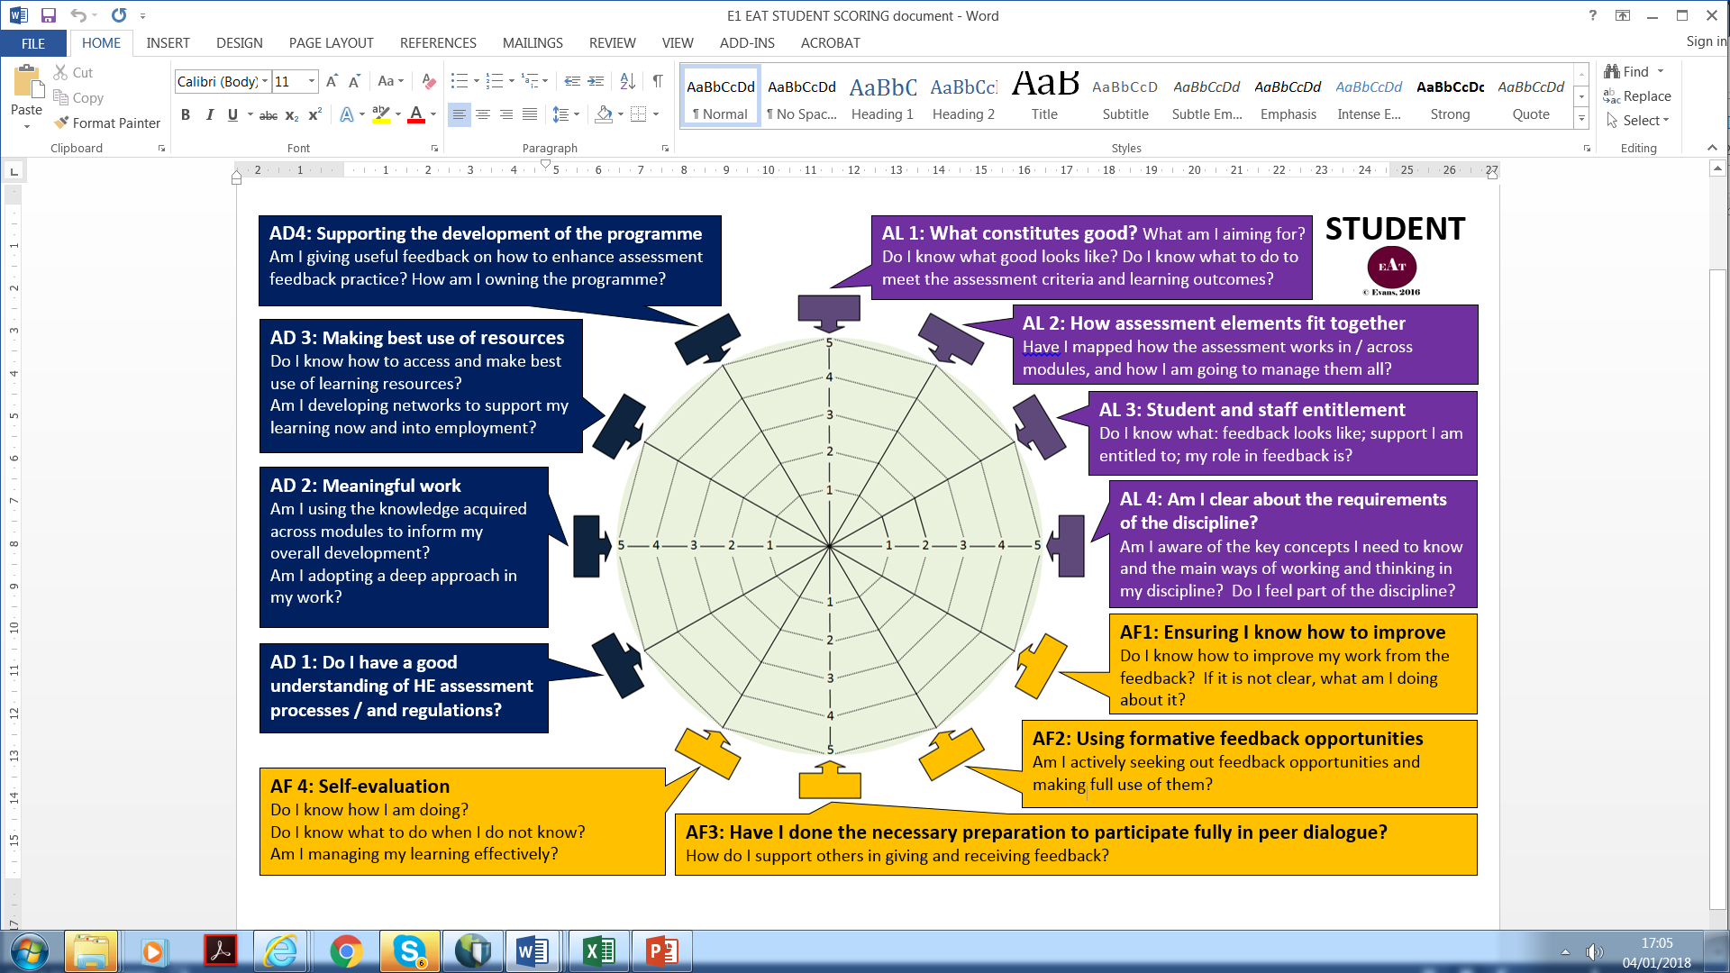

Slide 19
What is the core content that you want to assess?
What is the best way to assess key knowledge, skills, aptitudes?
How do you want students to spend their time?
Is feedback placed where it can do most good?
How are you ensuring a streamlined assessment approach?
How are you ensuring assessment is aligned?
What training is in place to ensure QA assessment literacy?
How are you ensuring assessment is fair?
How nimble is assessment design to effect change where needed?
EAT 5 Questions
© agsandrew/Shutterstock.com

